Slide 1
PROJECT REPORT
On
TITLE: MUNCH MATE
Submitted in partial fulfilment of the requirements of degree of
BACHELOR OF TECHNOLOGY
Computer Science and Engineering
TECHNO INDIA NJR INSTITUTE OF TECHNOLOGY, UDAIPUR
SESSION 2024

Slide 2
SUBMITTED BY:
Aashish Patel (20ETCCS001)
Amartya Panwar (20ETCCS007)
Devraj Singh Rao (20ETCCS032)
Dixant Mishra (20ETCCS038)
Mohammed Amaan (20ETCCS072)
Virendra Singh Panwar (20ETCCS115)

Slide 3
PROBLEM STATEMENT:
Despite the growing popularity of online food ordering platforms, many users still face challenges in finding a seamless and efficient ordering experience. Existing platforms often lack personalized recommendations, efficient search functionalities, and real-time updates on order status, leading to frustration and decreased user satisfaction. Additionally, restaurant partners encounter difficulties in managing orders effectively and maintaining a consistent brand experience across multiple online channels. Therefore, there is a pressing need to develop a comprehensive food ordering website that addresses these challenges by integrating advanced features such as personalized recommendations, intelligent search algorithms, real-time order tracking, and streamlined order management for restaurant partners. This project aims to design and implement a user-friendly and robust food ordering platform that enhances the overall experience for both customers and restaurant partners, thereby revolutionizing the online food delivery industry

Slide 4
OBJECTIVES AND SCOPE:
OBJECTIVE:
Enhance user experience on the restaurant website.
Implement a dynamic online reservation system.
Provide real-time table availability.
Enable user-friendly time slot selection.
SCOPE:
Integrate the reservation system with the existing website architecture.
Optimize for seamless user interaction.
Display real-time table availability.
Streamline the reservation process.
Improve overall website functionality.

Slide 5
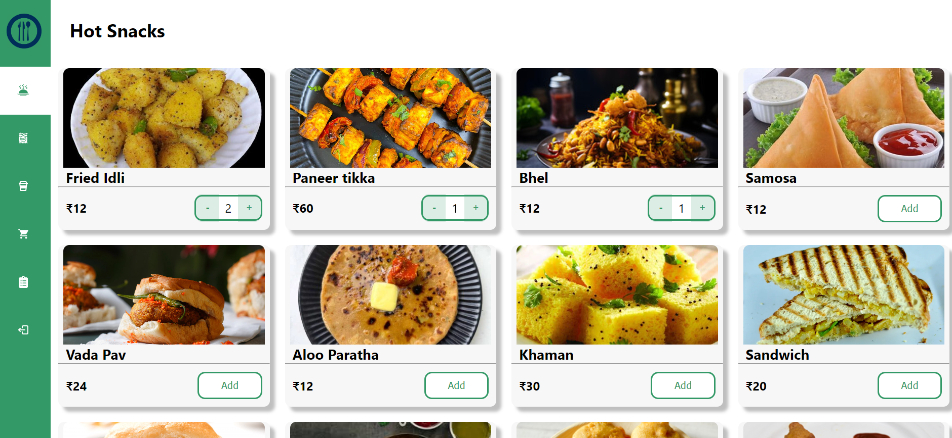
HOME PAGE

Slide 6
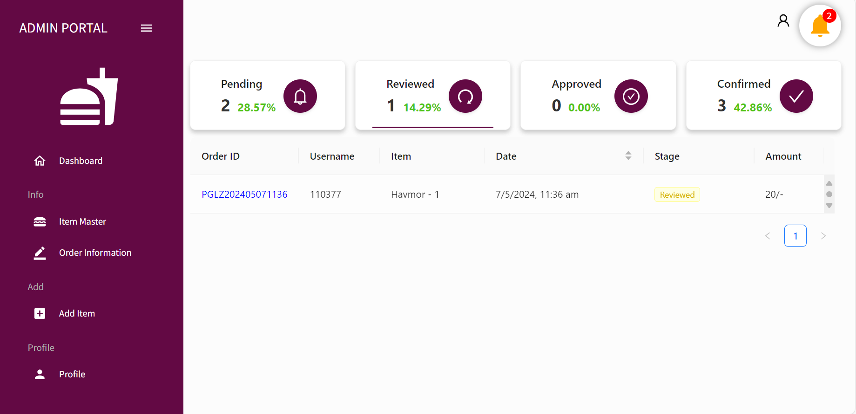
ADMIN PAGE

Slide 7
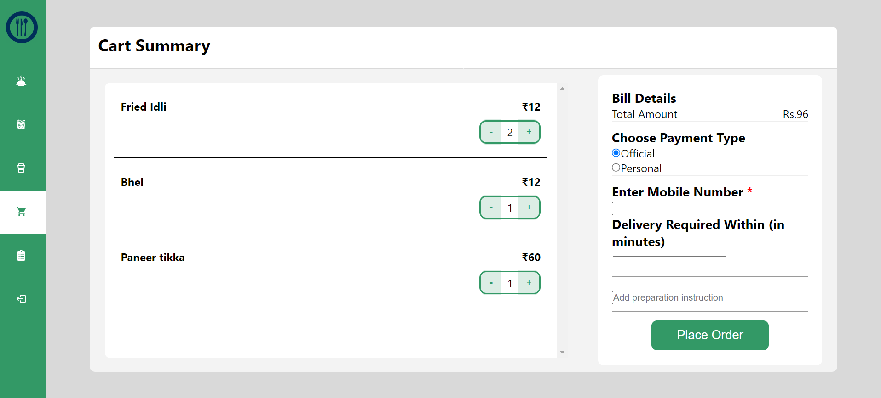
CART PAGE

Slide 8
METHODOLOGY:
Needs Assessment: Identify specific requirements and preferences for the online reservation system through consultations with the restaurant owner and potential users.
Technology Evaluation: Assess various technologies suitable for implementing a dynamic reservation system, considering compatibility with the existing website architecture.
System Design: Develop a detailed plan outlining the system architecture, user interface, and integration points to ensure a cohesive and seamless reservation experience.
Development: Implement the online reservation system based on the design, focusing on real-time data synchronization, intuitive user interfaces, and secure confirmation processes.
Integration: Seamlessly integrate the developed reservation system with the current website, ensuring minimal disruption and maintaining consistency across the platform.
Testing: Conduct rigorous testing to identify and resolve any bugs, glitches, or usability issues, ensuring a reliable and user-friendly experience

Slide 9
RESOURCES:
SOFTWARE:
REACT JS for front-end development.
NODE JS for server-side scripting.
POSTGRESQL for the database.
HARDWARE:
A web server to host the application.
Computers with internet access for users.

Slide 10
PROJECT TIMELINE:
1.Requirements Analysis: (WEEK 1-2)
Identify and document module requirements: Reservation, Menu Management, User Feedback, and Payment Processing.
2.System Design: (WEEK 3-4)
Plan architecture, database schema, and user interfaces.
Define user interaction for Reservation, Menu, Feedback, and Payment modules.
3.Implementation: (WEEK 5-12)
Develop using React JS, Node JS
Utilize a relational database (e.g., POSTGRE SQL).
Integrate modules seamlessly.

Slide 11
4.Testing: (WEEK 13-17)
Ensure thorough functionality, security, and user experience testing for each module.
5.Deployment: (WEEK 18-20)
Deploy the system on a web server accessible to authorized users.

Slide 12
FUTURE SCOPE:
Continuous Improvement of Visuals: Regularly update and enhance visual content for an enticing and appetizing online presentation.
User-Friendly Interface Evolution: Gather and implement user feedback to improve the menu interface, ensuring it remains intuitive and user-friendly.
Explore Innovative Promotions: Experiment with creative ways to promote specials and events, keeping customers engaged and eager to explore new offerings.
Adapt to Technological Trends: Stay abreast of technological advances and consider integration, such as mobile apps or emerging features, to maintain a competitive and modern online presence.

Slide 13
CONCLUSION:
The Restaurant Website project aims to revolutionize the dining experience by creating a user-friendly, automated, and efficient online platform. Catering to current industry needs while allowing for future enhancements and integrations, the project guarantees transparency, accuracy, and a seamless experience for both restaurant administrators and customers. Specific features include menu updates, online reservation management, order tracking, feedback collection, and seamless payment processing, ensuring a more organized and enjoyable dining experience for all stakeholders.

